Slide 1
tinyurl.com/ hackhyland2023
Everything you need to know for the Hackathon, all in one place!

Slide 2

Strive for Greatness
tinyurl.com/hackhyland2023

Slide 3
Friday Night Schedule
5-6PM | Session: Hacky Hour 🚀🖌🧪 | Auditorium
6-6:30PM | Dinner | Auditorium
6:30-7:15PM | Session: User Experience 🚀🖌🧪 | Auditorium
7:30-8PM | Session: Choosing a Tech Stack 🧪 | Auditorium
8-9:30PM | Workshop: Building a Website 🚀 | Auditorium
8-9:30PM | Workshop: Introduction to Git 🧪 | Training Room 2
10-11:30PM | Activity: Movie Night 🎞 | Auditorium
Full schedule available at tinyurl.com/hackhyland2023

Slide 4

Remember to stay hydrated
tinyurl.com/hackhyland2023

Slide 5
📶
Get Connected
Wi-Fi Network: Hackathon
Password: HylandSoftware!
tinyurl.com/hackhyland2023

Slide 6

Shoot for the Stars
tinyurl.com/
hackhyland2023

Slide 7
Earn Raffle Tickets
⚒
Attend Workshops
😇
Be Nice
❔
💪
Ask Good Questions
Work Hard
🎴
Help Others
WIN PRIZES
tinyurl.com/hackhyland2023

Slide 8

Don’t sweat the small stuff
tinyurl.com/hackhyland2023

Slide 9
Hold up!
Have to leave the building? Make sure you sign out with a mentor before you depart.
More information at tinyurl.com/hackhyland2023

Slide 10

Make every experience a learning experience
tinyurl.com/hackhyland2023

Slide 11


Contact
Discord
Phone
Email
Reach mentors and facilitators online
Caitlin: (216) 469-4921
Marissa: (216) 314-7660
Joseph: (216) 218-2609
Visit the Mentor Room
Send a message to techoutreach@hyland.com
More information at tinyurl.com/hackhyland2023

Slide 12

Take Time to Relax
tinyurl.com/hackhyland2023

Slide 13
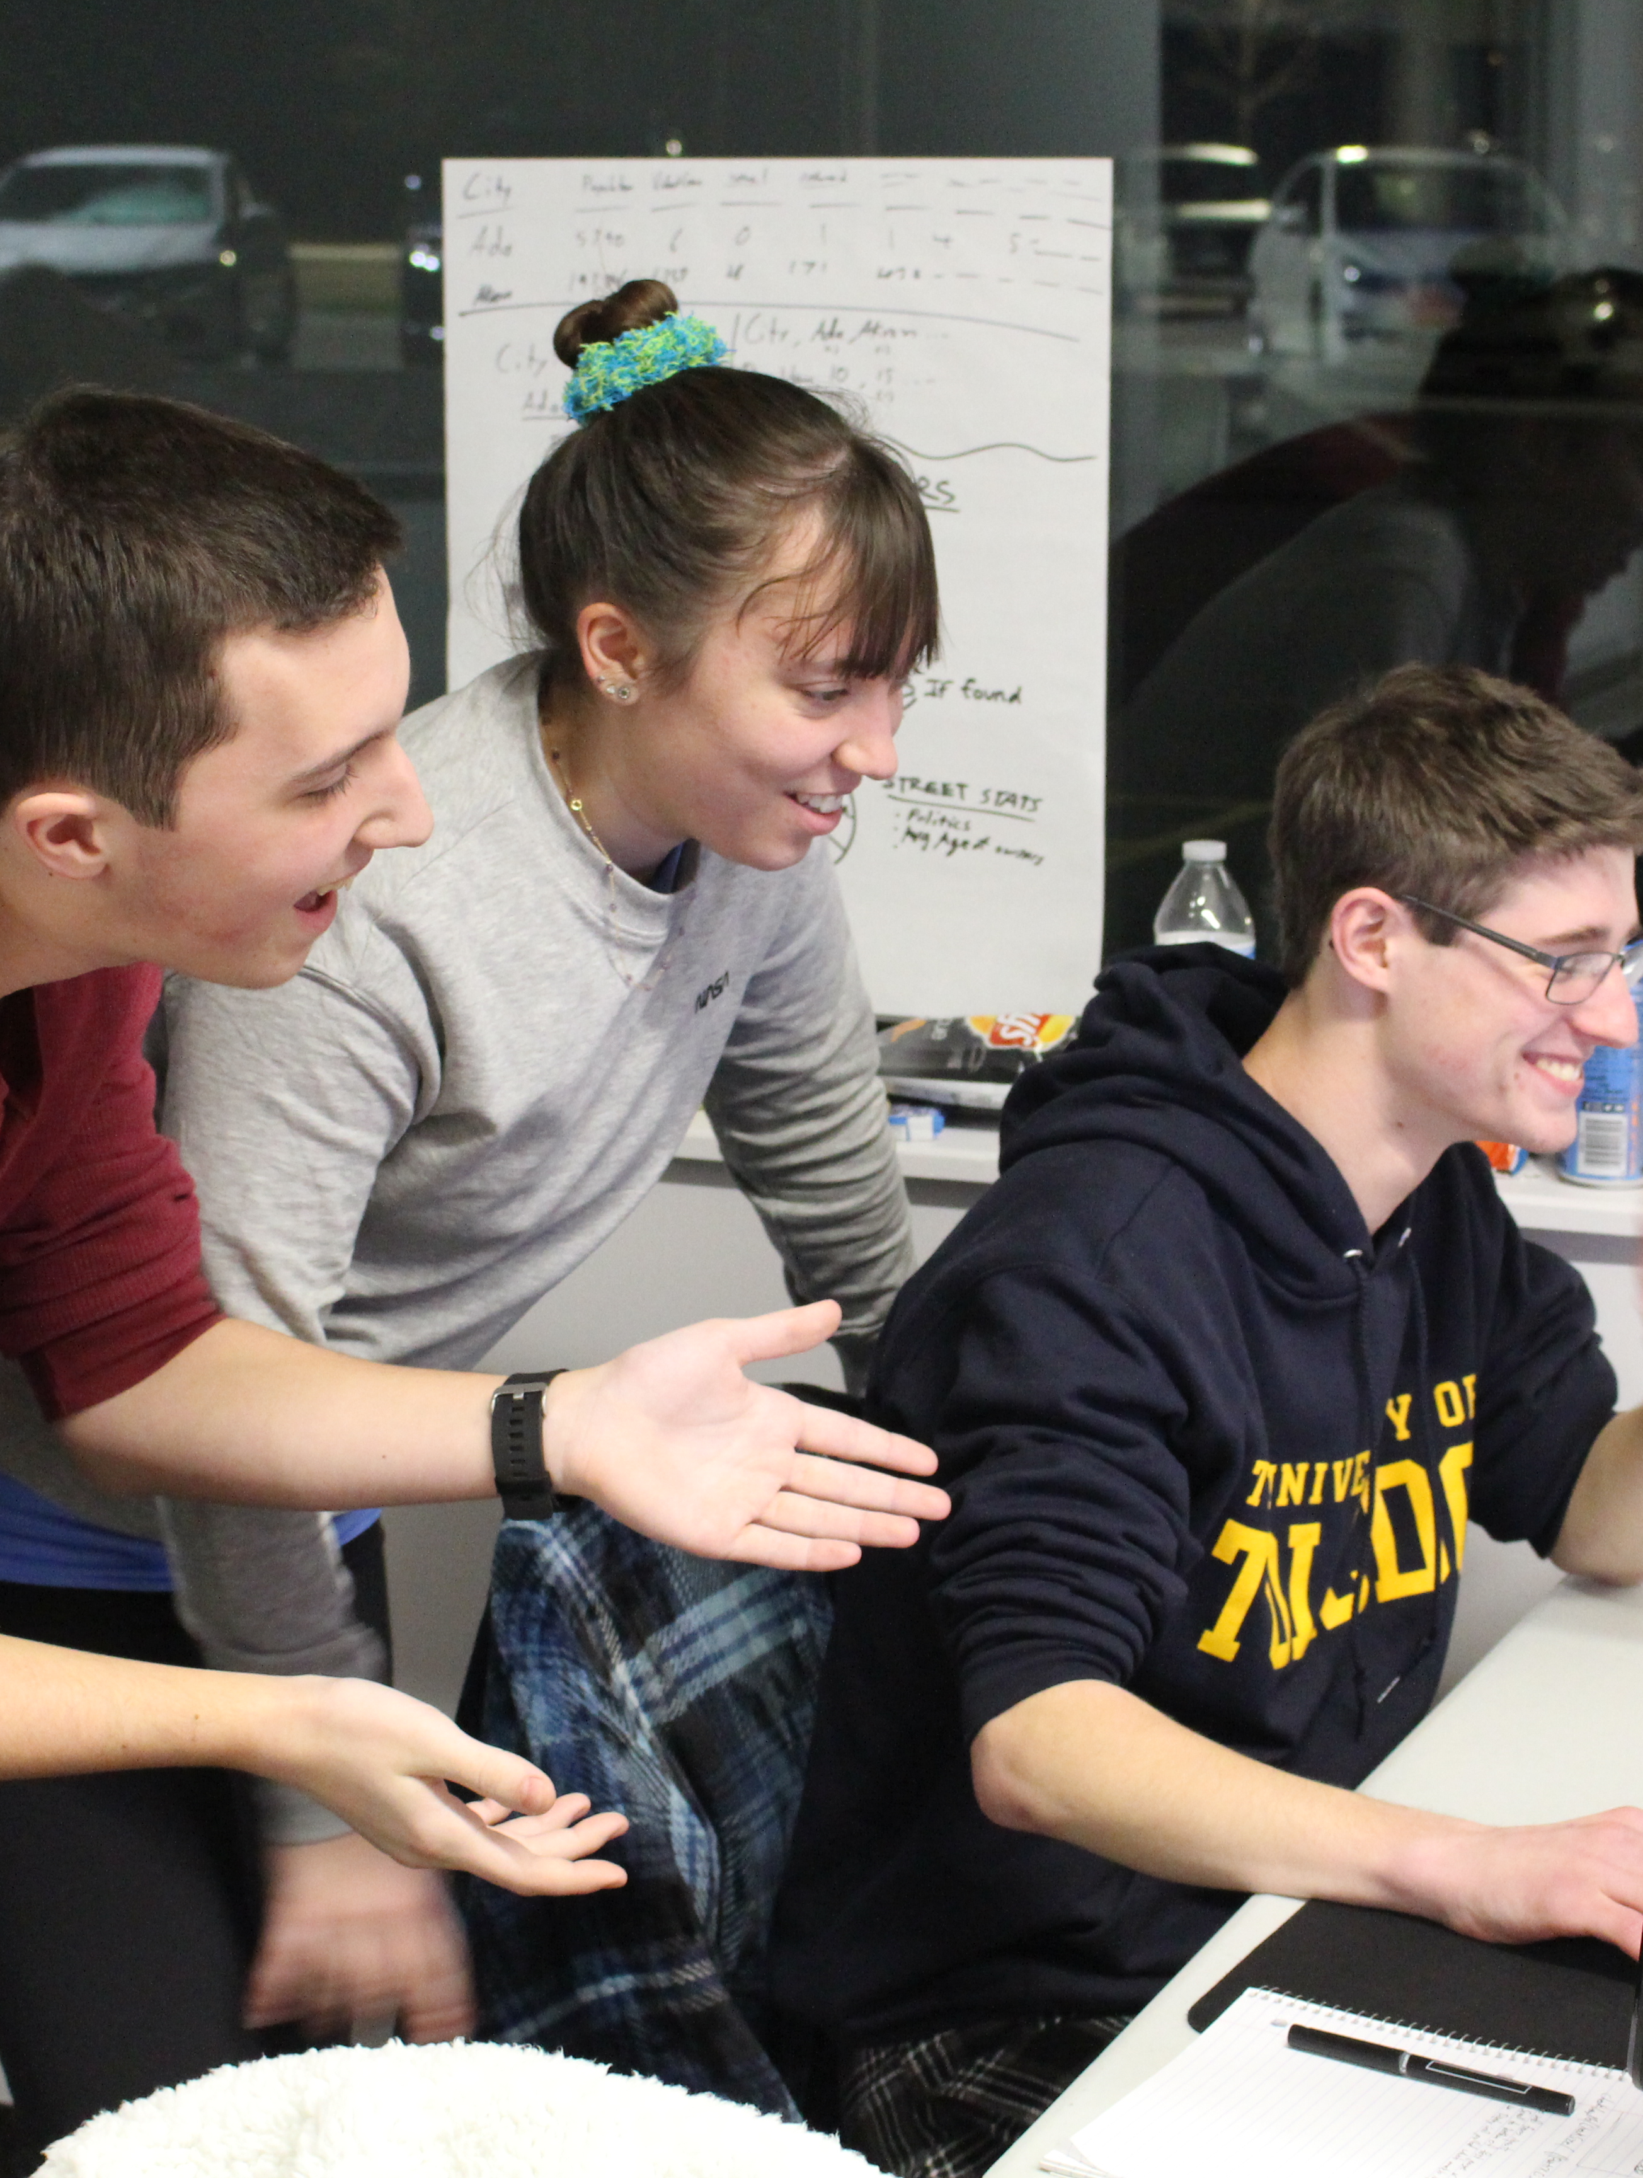
Photos & Posts
Share your Hackathon experience with the world
Use #HylandHackathon on your posts for a chance to be featured on Hyland social media 😎
tinyurl.com/hackhyland2023

Slide 14

Believe in Yourself
tinyurl.com/hackhyland2023

